Slide 1

A DISTRIBUTION OF WEALTH – NEW YORK
Ana Tipple, Chenita Francis-Hare, Chioma Juliet Uche, Lishani Srikaran, and Rohan Ram
Notes:
Hello everyone, today we will be having a conversation about a distribution of wealth in New York. (10 seconds).

Slide 2
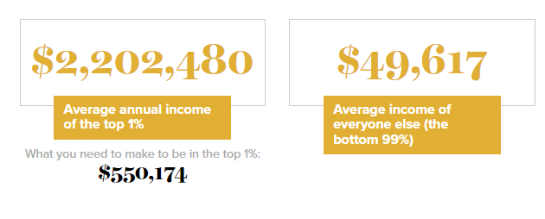
INTRODUCTION
(Economic Policy Institute 2023)
Notes:
- Within the US, New York State has some of the highest levels of income inequality.
- The top 1% make 44.4 times more than the bottom 99%, this is according to the Economic Policy Institute 2023.
(20secs)

Slide 3



“THEY SHOULD HAVE WORKED HARDER.”
(Save the Children 2023)
(Welcome to the Jungle 2021)
(Adobe Stock 2023)
Notes:
Within that 99%, there are some people who are really struggling day by day.
Some children grow up in poverty, they are hungry when they get to school which impacts concentration levels and must deal with more disruptive factors due to their household situation.
Full-time carers may have had to give up the dream of attending university meaning they are left with lower qualifications and less options.
- Or unfortunately, people are dismissed from opportunities due to their background, this can either be with intention or subconsciously.
(30secs)

Slide 4


CODING APPROACH
Notes:
We created three visuals to help show the distribution of wealth in New York, these visuals are displayed on a webpage which was built using HTML/CSS.
Our data sources consisted of a GEOJSON and 2 CSV’s.
All visualisations needed to be updated at the same time so the user could interact with them. Therefore, we created an index.html file which linked all our code scripts together. Each of the scripts that generate the visualisations are organised by programming languages inside a static folder.

Slide 5

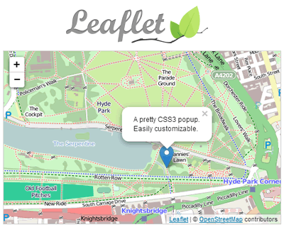
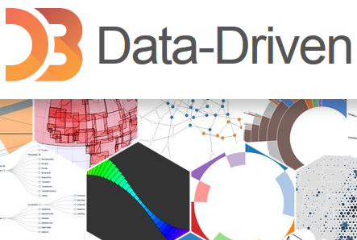
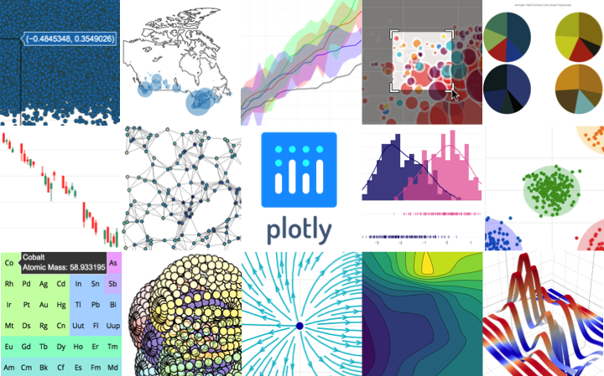
CODING APPROACH –
(Computer Hope 2023)
(Vegibit n.d.)
(Jquery Plugins 2013)
(Pypi 2023)
Notes:
The scripts to bring our visualisations to life were coded using JavaScript with the assistance of some libraries and plugins.
- D3 was very powerful as it allowed us to connect our cleaned data sources.
Leaflet allowed us to create a map object with layers.
Plotly allowed us to create a user interactive scatter plot and heat map.
We also used a Leaflet plugin to incorporate a reset button on our first visualisation.
Some coding techniques included: using functions to optimise our code, using for loops with conditionals to allow dynamic visualisations, and mapping was useful when obtaining the values to plot from a CSV.

Slide 6
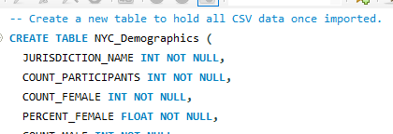
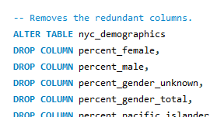
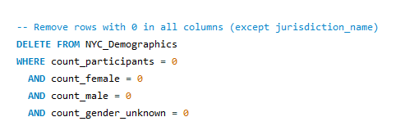
DATA WRANGLING TECHNIQUES
Anna
Notes:
The two CSV files needed to be cleaned before they could be used.
We created a table with columns that would support the content of the CSV’s.
The CSV’s were then imported the tables which had been created.
Redundant columns were removed.
Some rows had no data in and therefore they were removed as they didn’t offer additional insight.

Slide 7
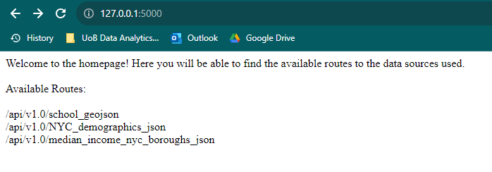
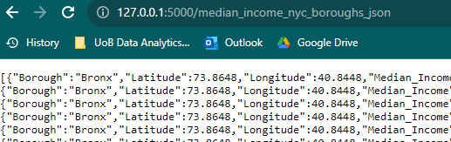
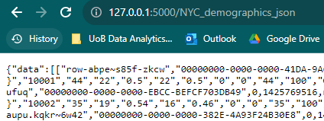
FLASK APP
Notes:
We created a flask application which allows an outsider to access all the datasources used for this project in one place.
The available routes are shown to the user on the main page.
When each route is visited, the dataset is available for the user to view.

Slide 8
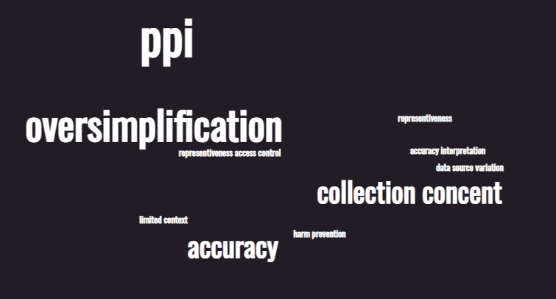
LIMITATIONS + ETHICAL CONSIDERATIONS
Uche
Notes:
Review for PII:
Data is at town level, does not contain obvious personal identifiers
Consent for collection:
No evidence of consent from municipalities or housing providers
However, given that we have selected to source data from government websites - we trust that the
Representativeness:
May underrepresent availability in certain neighbourhoods
Non-responsive towns likely outdated - however, we have cleaned the data sn
Access control:
Contains sensitive details requiring access controls
Limit access to authorized users
Transparency:
Disclose details on intended use of published list and also any limitations of the data
Explain ranking and appeals process
Accuracy:
Data compiled from multiple government sources
Variability in municipal response affects consistency
Interpretation:
We have provided context on what data does/doesn't indicate in order to avoid sweeping generalizations
Harm prevention:
Mitigate risks of misuse or stereotyping
Avoid penalizing municipalities
Data Source Variation
The data originates from diverse sources, including federal, state, and local programs, which may lead to inconsistencies and inaccuracies due to variations in reporting standards.
Dataset 3Data Specificity
The dataset provides information for the fiscal year 2019 only, limiting insights to that specific timeframe.
Limited Context
The dataset offers numerical data without extensive context, which may require additional information for comprehensive analysis.
Potential for Oversimplification:
The dataset's limited variables may oversimplify complex financial situations of the entities involved.
Dataset excludes other potentially relevant factors outside retirement contributions
PII
Doesn’t contain PII
Collection consent
Individual consent isn’t required as the data pertains to organizational and financial aspects rather than personal information about individuals.

Slide 9
REFERENCES
Arora, P. (2020, July 12). Minorities Around the World. Voices of Youth. https://www.voicesofyouth.org/blog/minorities-around-world
Child Hunger in America. (n.d.). Save the Children. https://www.savethechildren.org/us/charity-stories/child-hunger-in-america
Dante Lee International. (2019). 51% of American Students Are Considered Poor -- and Most Are From These 10 States! [Online image]. In Low Income Housing Authority. https://www.lowincome.org/2015/03/51-percent-american-students-poor-low-income.html
Detrick, B. (2013, June 26). Williamsburg’s Movie Houses: Where Popcorn Feels Passé. The New York Times. https://www.nytimes.com/2013/06/27/fashion/williamsburgs-movie-houses-where-popcorn-feels-passe.html
Diverse Group Serious Images – Browse 7,017 Stock Photos, Vectors, and Video. (n.d.). Adobe Stock. Retrieved August 14, 2023, from https://stock.adobe.com/search?k=diverse+group+serious
Gap between rich and poor, by state in the U.S. 2017 | Statistic. (2017). Statista; Statista. https://www.statista.com/statistics/227249/greatest-gap-between-rich-and-poor-by-us-state/
Interactive: The Unequal States of America. (n.d.). Economic Policy Institute. https://www.epi.org/multimedia/unequal-states-of-america/#/New%20York
Introduction To The D3 JavaScript Library. (n.d.). Retrieved August 14, 2023, from https://vegibit.com/introduction-to-the-d3-javascript-library/
Leaflet – JavaScript Library for Mobile Friendly Maps. (n.d.). JQuery Plugins. Retrieved August 14, 2023, from https://jquery-plugins.net/leaflet-javascript-library-for-mobile-friendly-maps
P, C. (n.d.). plotly: An open-source, interactive data visualization library for Python. PyPI. https://pypi.org/project/plotly/
The reality of quitting your job to become a full-time carer. (n.d.). Www.welcometothejungle.com. https://www.welcometothejungle.com/en/articles/the-reality-of-quitting-your-job-to-become-a-full-time-carer
‌What is JavaScript. (2019). What is JavaScript? Computerhope.com. https://www.computerhope.com/jargon/j/javascript.htm
‌
‌

Slide 10
DATA SOURCES USED FOR VISUALS
All data sources originated from government bodies.
Dataset 1 – (https://nces.ed.gov/programs/edge/economic/neighborhoodpoverty)
Household economic data from the Census Bureau’s American Community Survey (ACS) and public-school point locations developed by NCES to estimate the income-to-poverty ratio for neighbourhoods around school building.
Dataset 2 – https://catalog.data.gov/dataset/demographic-statistics-by-zip-code
Published by data.cityofnewyork.us which used information that is produced by the city’s government.
Dataset 3 – https://www.census.gov/quickfacts/fact/table/newyorkcitynewyork/HSG010222
United States Census Bureau (the official website of the United States Government)
‌
‌

